Slide 1

Static Timing Analysis Ehsan Yazdian

Slide 2
Static Timing Analysis
Even though a digital circuit may be logically correct, we need to know how it will perform in its physical implementation.
To meet a performance specification.
To evaluate how your design operates
Items of interest for analysis include:
Requirements for input signals to the circuit.
Internal performance, maximum clock frequency.
Behavior of output signals from the circuit.

Slide 3
Static Timing Analysis
Important timing parameters of the components in the circuit.
Combinational logic propagation delays.
Signal propagation delays through wire.
Sequential logic input requirements and output valid delays. (Setup time, Hold time)
Memory, Flip Flops, Latches

Slide 4
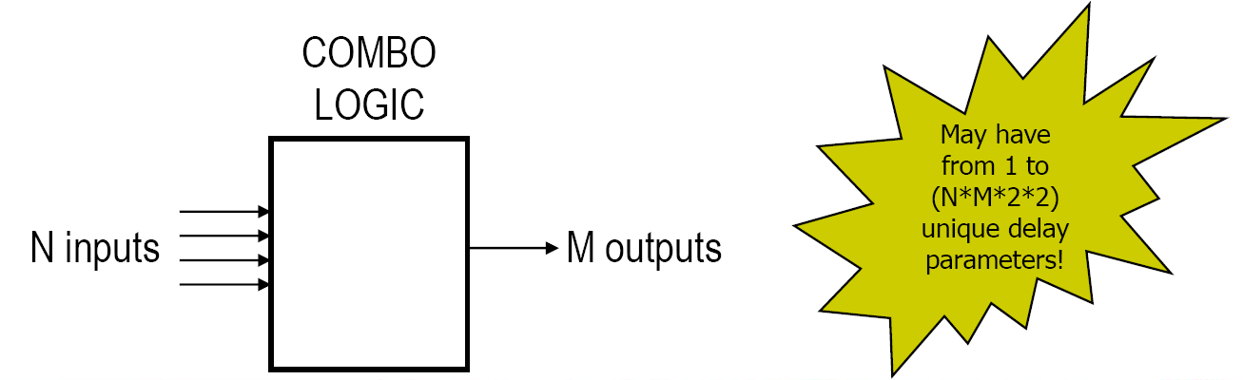
Combinational Logic
Combinational logic propagation delays.
Input to output propagation delays.
Always non-zero, because we live in reality.
Input rising versus falling delays can be different.
Worst case and best case delays (max/min).

Slide 5
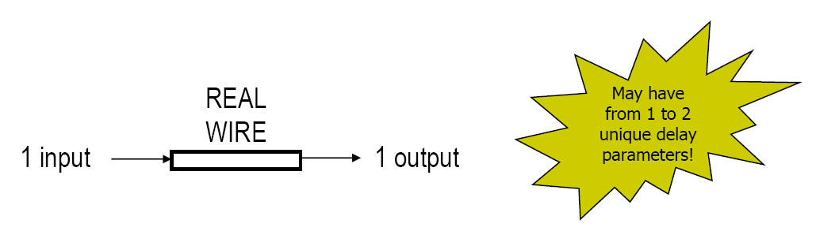
Wires
Signal propagation delays through wire.
Delays due to the physical nature of real wires such as resistance, capacitance, inductance.
Always non-zero, because we live in reality.
Worst case and best case delays (max/min).

Slide 6
Synchronous Design
Every clock cycle, the flip flops in a design will sample their inputs, store the value, and provide it at their outputs.
This happens at all flip flops, on all clock edges.
At the input side of the flip flops, the input setup and input hold requirements must be observed in order to guarantee predictable behaviour.
This applies on-chip, and between chips, as long as they are synchronous --a common clock.

Slide 7
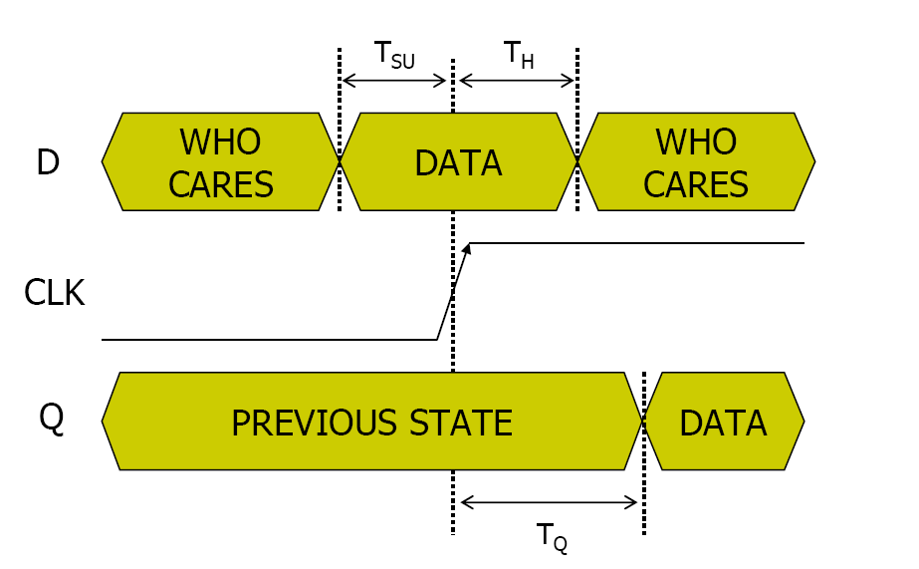
Register Elements
Data must be at rest during sampling window:
For a short time before (Input setup)
For a short time after (Input hold)
Some time after sampling event takes place, the sampled result is available (clock to out).

Slide 8
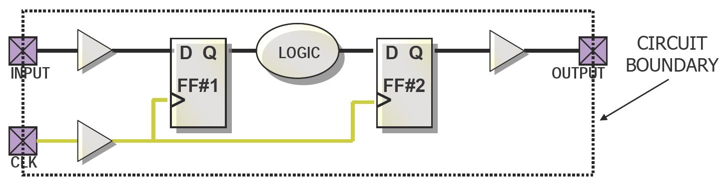
Synchronous Design
Items of interest for analysis include:
Requirements for input signals to the circuit.
Internal performance, maximum clock frequency.
Behaviour of output signals from the circuit.
Maximum clock frequency tells us how fast the circuit will operate.
Input and output behaviour tells us how the circuit interacts with other circuits and the outside world.

Slide 9
A Simple Example
Assume wire delays are T_{W}= 0 ns.
Buffers have delay of T_{B}= 1 ns
Logic has delay of T_{L}= 7 ns
Flip flops are identical with parameters:
Input setup is T_{SU}= 2 ns
Input hold T_{H}= 0 ns
Clock to out is T_{Q}= 1 ns
T_{QFF1}+ T_{L}+ T_{SUFF2}= 10 ns ⇒100 MHz max
PAD to Clock :
T_{B} + T_{SUFF1}- T_{B,Clk} = 2ns
Clock To PAD :
T_{QFF2}+ T_{B} + T_{B,Clk} = 3 ns

Slide 10
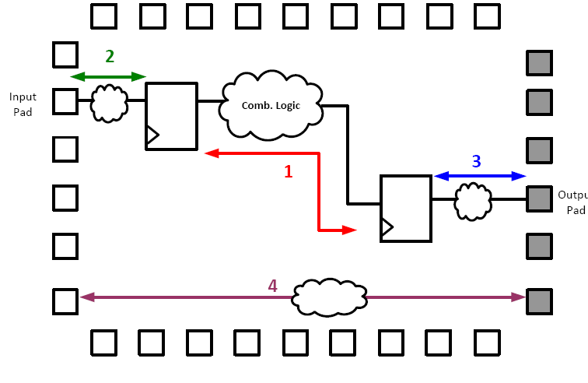
Critical Path
Critical path in any design is the longest path between
Any two internal latches/flip‐flops
An input pad and an internal latch
An internal latch and an output pad
An input pad and an output pad
Use FFs right after/before input/out pads to avoid the last three cases
The maximum delay between any two sequential elements in a design will determine the max clock speed

Slide 11
Design Constraints
The Implementation tools don’t try to find the place and route that will obtain the best speed.
Instead, the Implementation tools try to meet our performance expectations.
Timing Constraints improve the design performance by placing logic closer together so shorter routing resources can be used.

Slide 12
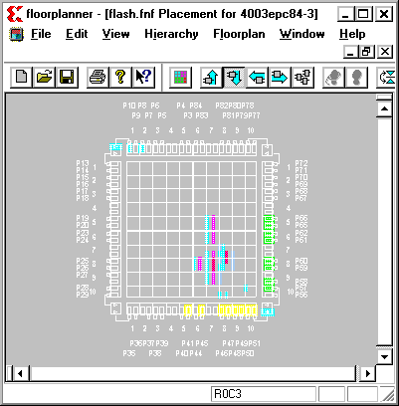
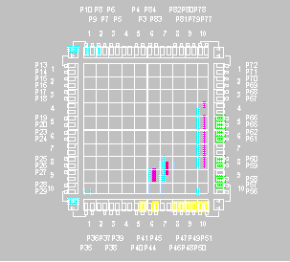
Timing Constraint
Without global timing constraintsLogic tends to be grouped to improve internal timing at the expense of I/O timing
With global timing constraints
All timing paths are evaluated
I/O paths are improved (CLBs are place closer to I/O pins)

Slide 13
Timing Constraints
Timing constraints define your timing objectives
Over-constraining gets you nothing, but costs extra PAR time
Always use timing constraints, even when your timing objective is modest
Unrealistic timing constraints will cause the tools to stop
After implementing, review the Post-Place & Route Static Timing Report to determine if your objectives were met
If your constraints failed, use the Timing Report to determine the cause

Slide 14
Combinational: PAD to PAD
Purely combinatorial delay paths do not contain any synchronous elements
ADATA
FLOP1
FLOP2
FLOP3
OUT1
D
Q
D
Q
D
Q
CLK
BUFG
FLOP4
FLOP5
D
Q
D
Q
OUT2
BUS [7..0]
CDATA
= Combinatorial Logic

Slide 15
Sequential
Register to Register
PAD to Clock/Register
Clock/Register to PAD

Slide 16
Clock Tree Synthesis
Clock is one of the most important signals in a chip, do not take it as others.
Clock Issues:
Heavy clock loading
Delay of long clock lines
Clock Skew
Clock Power Consumption: The largest proportion of power in the FPGA

Slide 17
Clock Issues
Clock Skew:
Clock skew between any tow connected registers:
Destination clock delay - Source clock delay.
There are two types of clock skew:
Negative skew: when the destination register receives the clock tick earlier than the source register.
May result in setup violation or decreasing the maximum frequency
Positive skew: when the destination register gets the clock tick later than the source register.
May result in decreasing the minimum period or increasing the maximum frequency.
Very large positive skew may results in hold violation.
We should minimize the absolute of clock skew.
In a real design, clock skew may be more than 10% of a period.
Clock Power Consumption:
Consumes the largest proportion of power in the FPGA.
Clock is connected to many sinks.
Clock nets are so long.

Slide 18
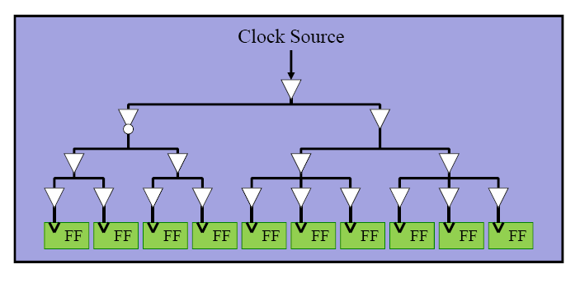
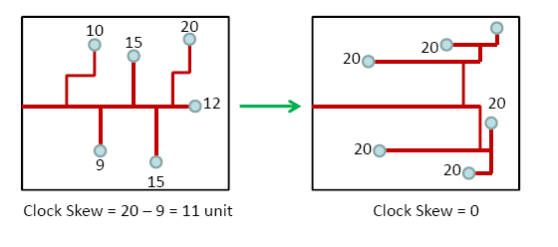
Decreasing Clock Skew
Using Clock Tree:
Implementing a Clock Tree and using buffers, reduce the clock skew and balance different clock lines.
Using global buffers (BUFG ) to distribute clock signals to minimize clock skew
Most synthesis tools can automatically use global buffers for clock signals
Phase-Locked Loop (PLL), is used to minimize clock skew .

Slide 19
Example of Clock Skew
Assume wire delays are T_{W}= 0 ns.
Buffers have delay of T_{B}= 1 ns
Logic has delay of T_{L}= 7 ns
Flip flops are identical with parameters:
Input setup is T_{SU}= 2 ns
Input hold T_{H}= 0 ns
Clock to out is T_{Q}= 1 ns
Think on situations where clock wire between two FFs, has some delay (Skew).
If cock arrives at FF1 earlier than FF2 (positive skew: +2ns)?
T_{period}= 10 ns-2ns =8ns ⇒125 MHz max
If cock arrives at FF2 earlier than FF1 (negative skew: -2ns)?
T_{period}= 10 ns+2ns =12ns ⇒ 83 MHz max
It can be seen that in some situations the clock skew may result in increasing the frequency of the design.

Slide 20
The Period Constraint
The Period constraint optimizes all delay paths between flip-flops
The Period constraint does NOT optimize delay paths
from input pads to output pads (purely combinatorial)
from input pads to flip-flops,
from flip-flops to output pads
ADATA
FLOP1
FLOP2
FLOP3
D
Q
D
Q
D
Q
OUT1
BUFG
FLOP4
FLOP5
D
Q
D
Q
OUT2
BUS [7..0]

Slide 21
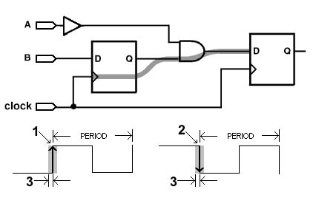
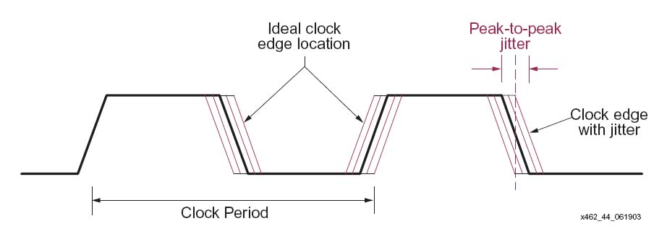
PERIOD Constraint Considerations
Clock skew between the source and destination flip-flops
Synchronous elements clocked on the negative edge
Clock jitter (main source of clock uncertainty) always decrease the frequcy (always harmfull)

Slide 22
OFFSET IN Constraints
The Offset In constraint covers paths from input pads to synchronous elements.
Example : OFFSET = IN 2 ns VALID 16 ns BEFORE “clk";
This constraint tells the tools that data will be setup at PADs 2 ns before the clk rising edge, and that the data will remain valid for 16 ns after it arrives. This constraint only applies to PADs that go to registers that are clocked by clk.
OFFSET IN
OFFSET OUT
ADATA
FLOP
FLOP
FLOP
D
Q
D
Q
D
Q
OUT1
CLK
BUFG
FLOP
FLOP
D
Q
D
Q
OUT2
BUS [7..0]
CDATA
= Combinatorial Logic

Slide 23
OFFSET OUT Constraints
The Offset Out constraint covers paths from synchronous elements to output pads
Example: OFFSET = OUT 3 ns AFTER “clk“;
This constraint tells the tools that you need to ensure that data is at the output pin of the FPGA 3 ns after a clock transition at the input of the specified clock to the FPGA.
OFFSET IN
OFFSET OUT
ADATA
FLOP
FLOP
FLOP
D
Q
D
Q
D
Q
OUT1
CLK
BUFG
FLOP
FLOP
D
Q
D
Q
OUT2
BUS [7..0]
CDATA
= Combinatorial Logic

